Slide 1
PIP-102: UNIVERSITY PROJECT-II (PROJECT) Review-1 Presentation Healthcare Chatbot powered by Artificial Intelligence
Submitted to the Presidency University, Bengaluru in partial fulfillment of the requirements for the PIP-102: PROFESSIONAL PRACTICE-II (PROJECT)
By
Batch No: 80
Under the supervision of
Sapna R Assistant Professor Department of Computer Science & Engineering June , 2022
Student Details
Name | MOHAMMED FURQAN AHMED | MOHAMED FAHAD IDREES | MOHAMMED ABDUL WAHAB AHMED | NALLAGARI UDAY KUMAR REDDY | N VASEEM BASHA
Roll No | 20181CSE0430 | 20181CSE0422 | 20181CSE0425 | 20181CSE0464 | 20181CSE0458
Section | 8CSE7 | 8CSE7 | 8CSE7 | 8CSE7 | 8CSE7
Batch No | 80 | 80 | 80 | 80 | 80
1

Slide 2
MEDIBOT
A Healthcare ChatBot

Slide 3
CONTENTS
Introduction
What is a MediBot ?
Algorithms Used
Architecture Diagram
Why use a MediBot ?
Advantages of using a Chatbot
Future Enhancements

Slide 4
INTRODUCTION
Artificial Intelligence (AI) in varying forms and degrees has been used to develop and advance a wide spectrum of fields including healthcare. From enhancing patient experience and helping medical professionals, to improving healthcare processes and unlocking actional insights medical or healthcare chatbots can be used for achieving such various objects. Poised to change the way payers, medical care providers, and patients interact with each other, medical chatbots are one of the most matured and influential AI powered healthcare solutions developed so far.

Slide 5
WHAT IS A MEDIBOT ?
Medical chatbots (a.k.a medibot for short) are AI-powered conversational solutions that facilitates the job of a healthcare provider and helps improve their performance by interacting with the users in a human like way.

Slide 6
ALGORITHMS USED
1.NATURAL LANGUAGE PROCESSING (NLP) :
To provide a better user experience based on the input of the user.
2.DECISION TREE ALGORITHM :
To help customers to find exactly what they are looking for.
3.SUPPORT VECTOR MACHINE :
They are used for classification, regression and outliners detection.

Slide 7
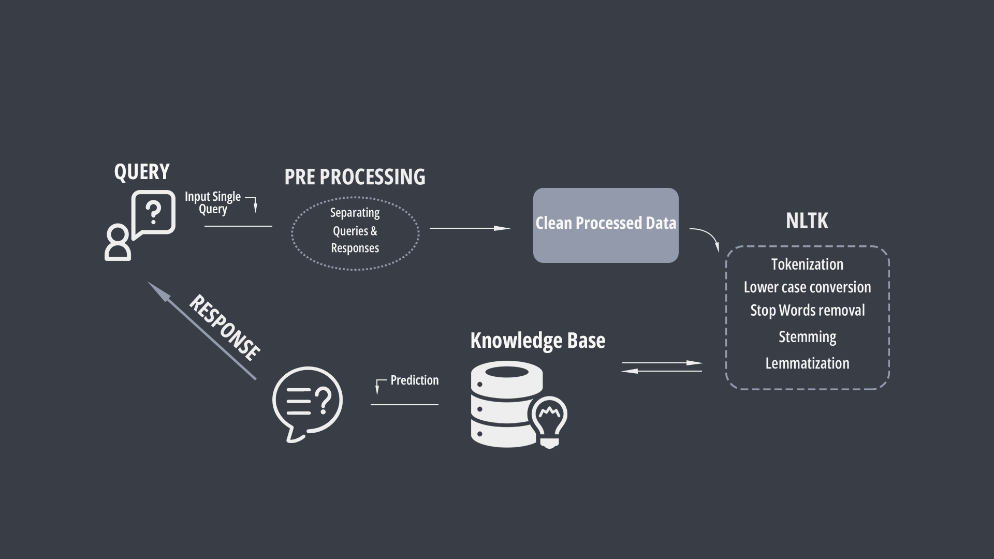
ARCHITECTURE DIAGRAM

Slide 8
WHY USE A MEDIBOT ?
All healthcare providers are always willing to help their patients, but the overwhelming workload doesn’t always let them provide the best service. In such cases a chatbot can be used to fill up the gap between a healthcare provider and the user.

Slide 9
ADVANTAGES OF USING A CHATBOT
A chatbot can :
1.Connect with the right specialist and provide the best first aid possible.
2. With technology, healthcare companies can deliver customer service without the requirement of additional resources.
3.They help overcome staff shortages with robotic assistance and thus overall improve the patient satisfaction.

Slide 10
FUTURE enhancements
With the use of Augumented Reality and advancements in the field of AI , chatbots can be made more human like future.
They can be trained to capture customer expressions and emotions and give response by using sentiment analysis.
By using more simple and user friendly UI, chatbots can improve interaction with the user.

Slide 11
THANK YOU

